Slide 1

Vial Counting Using Image Processing-193
Presented by GAYAL C ASHOK

Slide 2
Project Leadership
SREEKANTH PUTSALA
Associate Datascientist

Slide 3
Team Members
Name: GAYAL C ASHOK
https://www.linkedin.com/in/gayal-c-ashok-26292b280?

Slide 4

Contents
Business objective
Business Constraints
Project Architecture
Data collection and details
Exploratory Data Analysis
Visualization
Modeling
Evaluation
Deployment
Notes:
Change

Slide 5
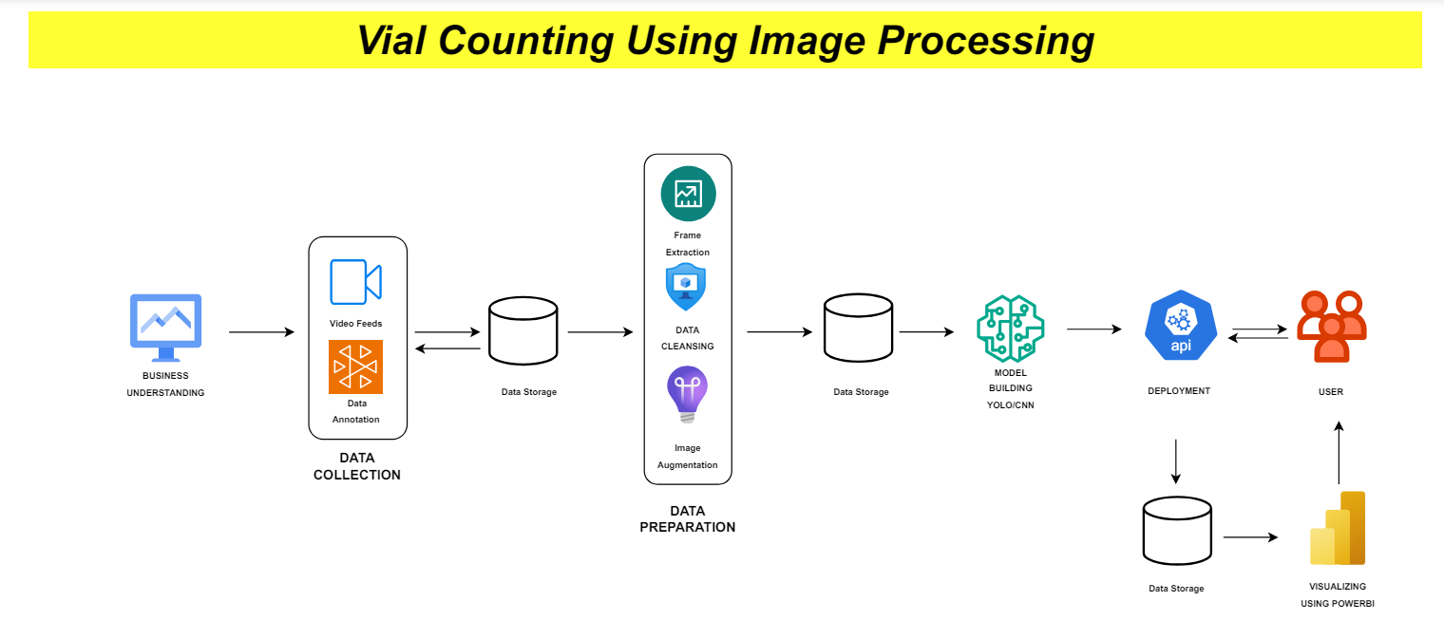
Project Overview and Scope

Slide 6
Business Problem
The challenge is to design a counting system for syringes and vials that streamlines operations and mitigates the risk of human error, ultimately optimizing productivity and accuracy in the process.

Slide 7
Business Objective
Objective
Constraints
Maximize efficiency and Minimize manual errors in inventory management
Minimize the cost of solution.

Slide 8
CRISP-ML(Q) Methodology
There are six stages of CRISP-ML(Q) Methodology
1.Business and data understanding
2.Data preparation
3.model building
4.Model evaluation
5.Model deployment
6.Monitoring and maintenance

Slide 9
Technical Stacks
Software Requirements:
Operating System:
Windows 11 (64-bit)
Python:
Version 3.x
Python Libraries:
    Streamlit
    ultralytics
    torchvision
    Deep learning techniques:
    Computer vision is a field of artificial intelligence (AI) and computer science that focuses on enabling computers to interpret and understand the visual world, similar to the way humans do. It involves developing algorithms and techniques for computers to gain a high-level understanding from digital images or videos.

Slide 10
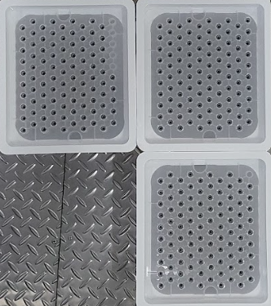
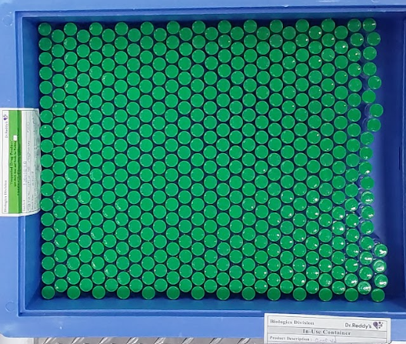
Data Description
Number of total images: 78
Format of images: jpg
Number of images after augmentation:190 e.g.
Number of images trained:168
validated:17
tested:5

Slide 11
System Requirements
Hardware:
Laptop:
Processor: Intel Core i5 or AMD Ryzen 5 (or higher)
RAM: Minimum 8GB
Storage: At least 256GB SSD
Operating System: Windows 11 (64-bit)
Software:
Operating System: Windows 11 (64-bit)
Python: Version <=3.8
Google collab
Python Libraries:
  ultralytics
  Pytorch
  Streamlit

Slide 12
Data Preprocessing
Preprocessing used:
Resize 640x640:In machine learning applications, resizing is often performed as part of data pre-processing to ensure that all input images have the same dimensions, which simplifies the training process and ensures that the model can learn effectively from the data . Here in this data we used 640x640 image resize to ensure all images are all one size in storage and efficient in model training.
Notes:
Keep observations

Slide 13
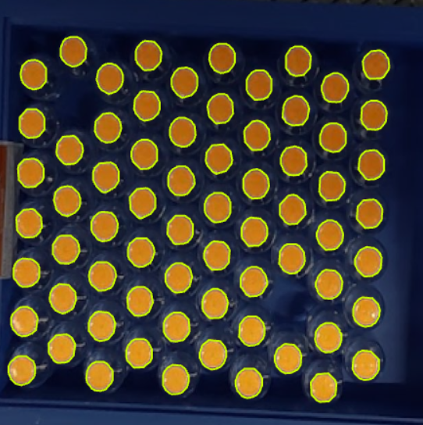
Data Visualization
Data is visualized using roboflow and annotated each individual pipe by hand to for model to understand bonding box of each pipe efficiently.
In this sample image there are five classes and five pipe in each class. Each class is highlighted in separate colors this classification will make the model building and runtime of model efficient and easy.
Notes:
Add graphical

Slide 14
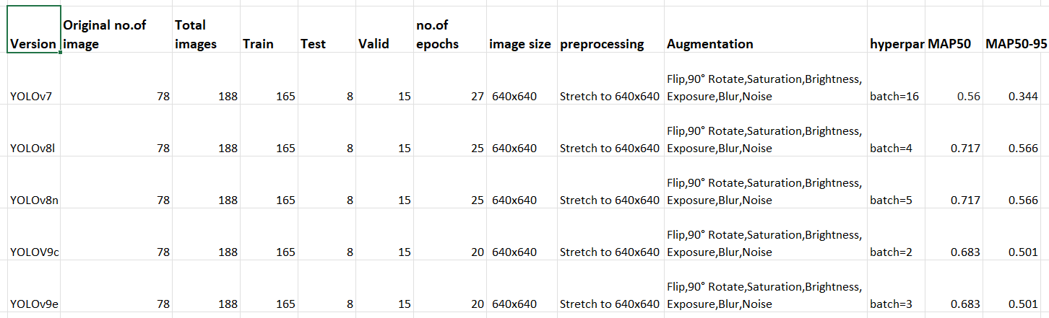
Model Building
Notes:
classification is the task of predicting a discrete class label. Regression is the task of predicting a continuous quantity.
What is classification techniques in machine learning?
The Classification algorithm is a Supervised Learning technique that is used to identify the category of new observations on the basis of training data. In Classification, a program learns from the given dataset or observations and then classifies new observation into several classes or groups.
What is regression techniques in machine learning?
Regression is a technique for investigating the relationship between independent variables or features and a dependent variable or outcome. It's used as a method for predictive modeling in machine learning, in which an algorithm is used to predict continuous outcomes.

Slide 15
Best Model –
Yolov8n and yolov8i:
By far yolov8n and yolov8i was the best model achieving accuracy of MAP50: 0.717 and MAP50-95 : 0.566. In validation data yolov8n and yolov8i performed well by recognizing all the classes and right number of vials and syringes in the images .
Notes:
Why Random Forest Regression is good?
A Random Forest Regression model is powerful and accurate. It usually performs great on many problems, including features with non-linear relationships
How is XGBoost different from random forest?
One of the most important differences between XG Boost and Random forest is that the XGBoost always gives more importance to functional space when reducing the cost of a model while Random Forest tries to give more preferences to hyperparameters to optimize the model..
n_estimators — the number of decision trees you will be running in the model

Slide 16
Model Deployment - Strategy
Batch Inference via Streamlit Application:
In this approach, the deployed model receives input data in image format, typically through a user interface. Users upload an image in jpg , png , jpeg , etc and the deployed application processes this image and generating image with bounding box each identified pipes in each class . This method is appropriate when users need to see where the pipe in image is counted.

Slide 17
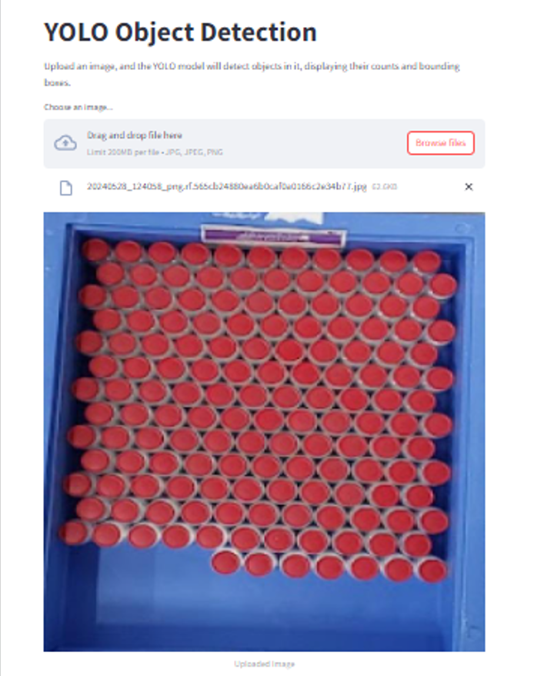
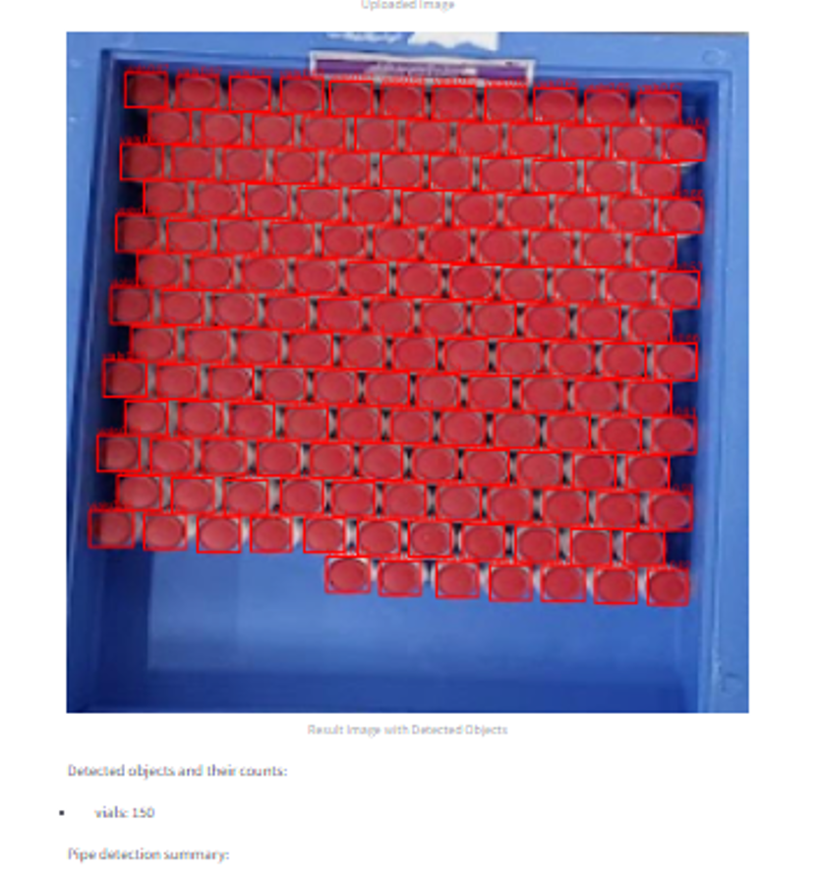
Screen shot of output

Slide 18
Challenges
Annotation : the annotation part is tedious to work on each image and annotate each image by hand.
Model choosing : choosing a model to train our data and learning all the model is not easy there is a lot of model in internet and each has its own pros and cons.
Training : after choosing a model to build we need to train the data on the model and get the best weight in which the model is getting the highest desirable accuracy . This will take time because the training part is hardware demanding and time consuming.
Deployment: after training, validating and testing we get a set of weights that is the best to identify pipes in any images we give to our program. So we need to develop a good interface in this case streamlit.

Slide 19
Future Scopes
Multi-Class Object Detection: Extend the project to support detection of a broader range of object classes beyond the ones currently implemented. This could involve expanding the model's training data to include additional classes and updating the class labels and detection logic accordingly.
Real-time Video Processing: Enhance the project to support real-time object detection in video streams. This would involve modifying the application to process video frames sequentially, applying the object detection model to each frame, and displaying the results in real-time.
Integration with Other Technologies: Integrate the object detection functionality with other technologies or services to enhance its capabilities. For example, incorporating image enhancement techniques, post-processing algorithms, or cloud-based services for additional analysis or data processing.
User Interface Improvements: Continuously improve the user interface of the application to enhance usability, accessibility, and user experience. This could involve refining the layout, adding interactive features, or optimizing performance for different devices and screen sizes.

Slide 20

Queries ?

Slide 21


